Slide 1

Trading Strategies for Cryptocurrencies: Are Technical Indicators Useful for Trading Cryptocurrencies?
Group Members: CHIN Joo Ern, LOH Yi Lin, LU Yu Xiao, YANG Cheng Ran, YANG Zhou

Slide 2
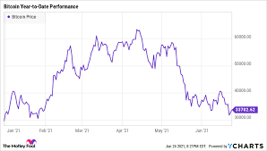

Trading is a risky activity, the topics discussed, and suggestions made in this presentation are meant solely for educational purposes and not for encouraging trading activity.

Slide 3

Contents of Presentation
Objective of Research
Trading Basics
Data Collection and Processing
Main Models
Model Assessment
Modifying and Adding Terms
Alternative Model (ECM)
Robustness Check
Significant Events
Google Trends
Developing and Evaluating Trading Strategies
Conclusion

Slide 4
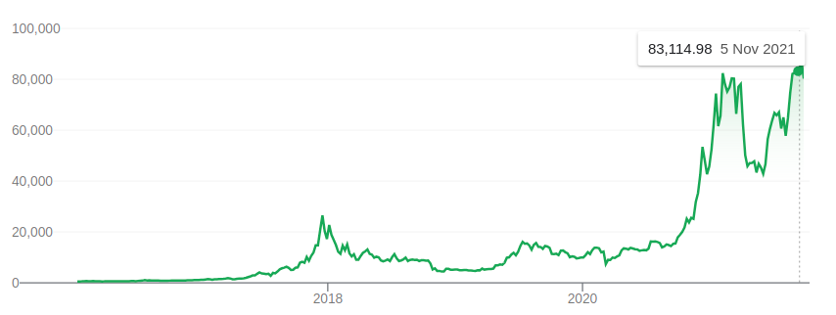



Exponential price increase, many chances for profit

Slide 5

Objective of Research
Develop an enhanced trading strategy using insights derived from an autoregressive distributed lag (ADL) time series model based on existing strategies and other regressors.
Fit time series data to autoregressive distributed lag model and derive insights
Develop a trading strategy based on derived insights
Assess performance of trading strategy against common basic trading strategies
Improve model and derive further insights

Slide 6

Trading Basics

Slide 7

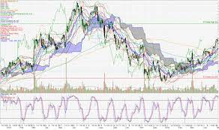
Trading Basics
Buying and selling of instruments is a common method for trading
Analysis can be used to support trading decisions.
Fundamental analysis examples: revenue, profit, assets, cash flow, company's key executives
Technical analysis examples: candlestick patterns, technical indicators, support and resistance

Slide 8
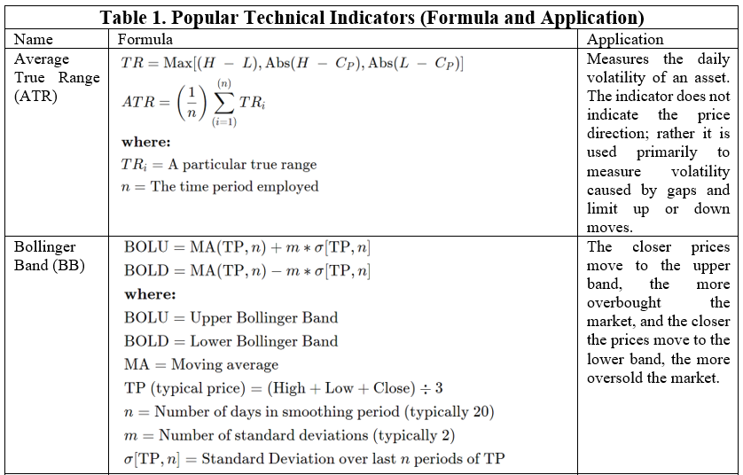

Slide 9
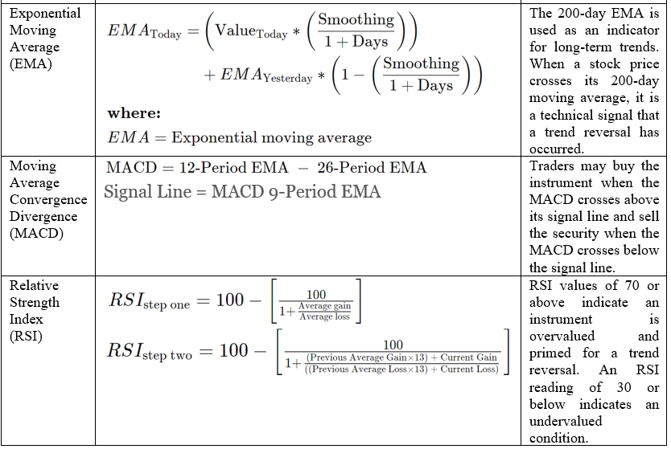

Slide 10
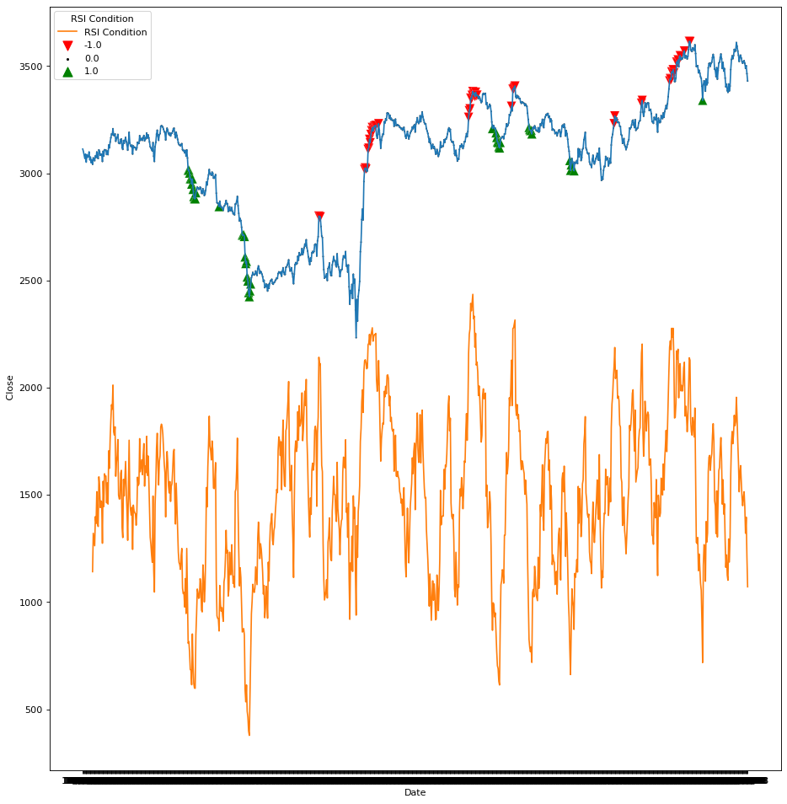
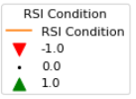
RSI Trading Strategy

Slide 11
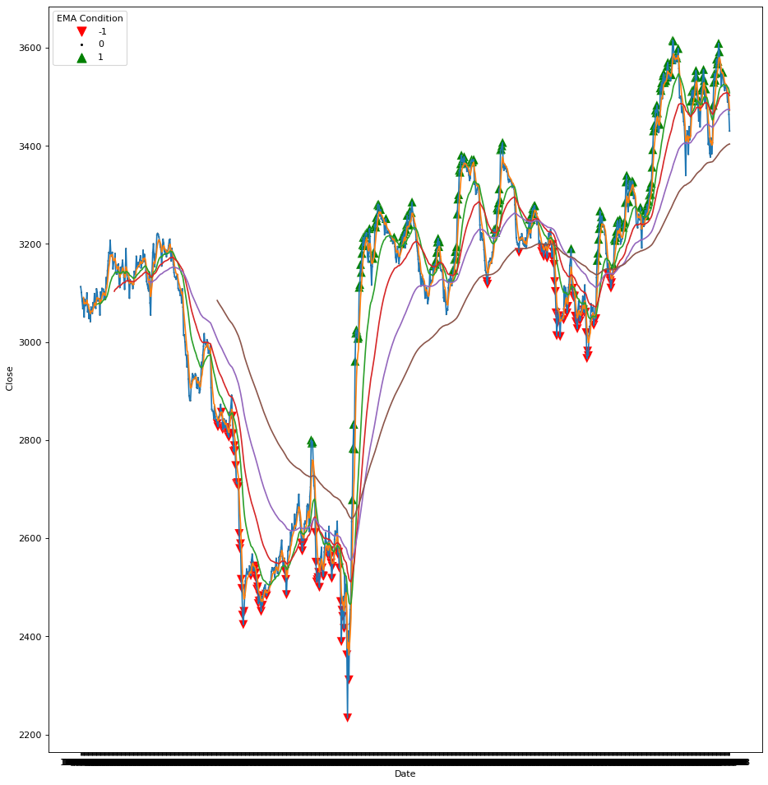
EMA Trading Strategy

Slide 12
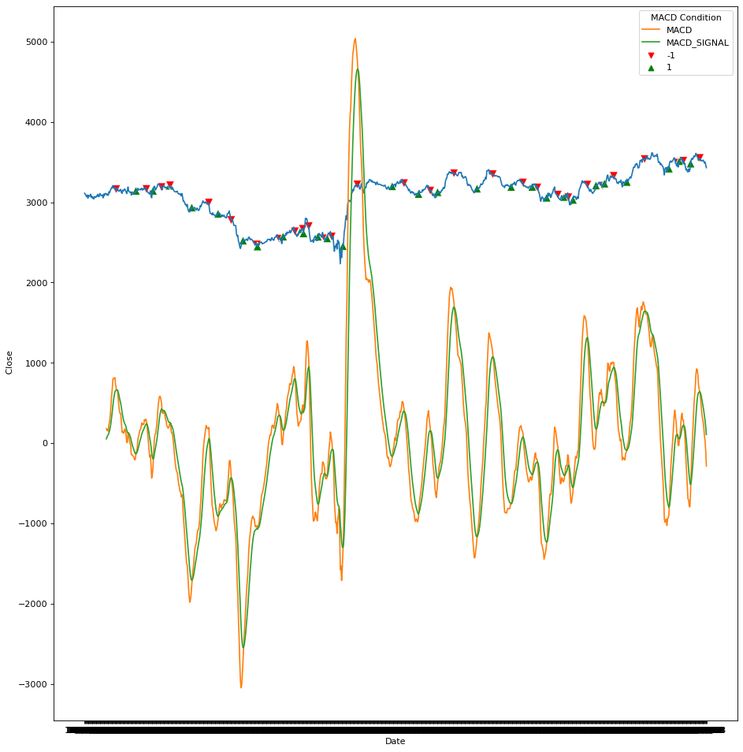
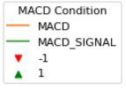
MACD Trading Strategy

Slide 13
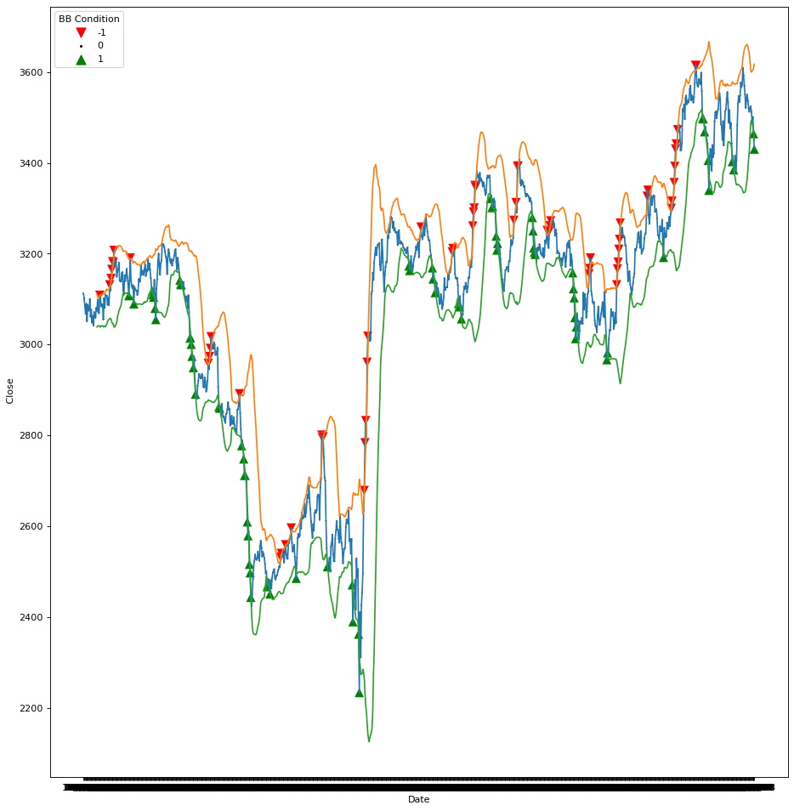
BB Trading Strategy

Slide 14

Data Collection, Model Development

Slide 15
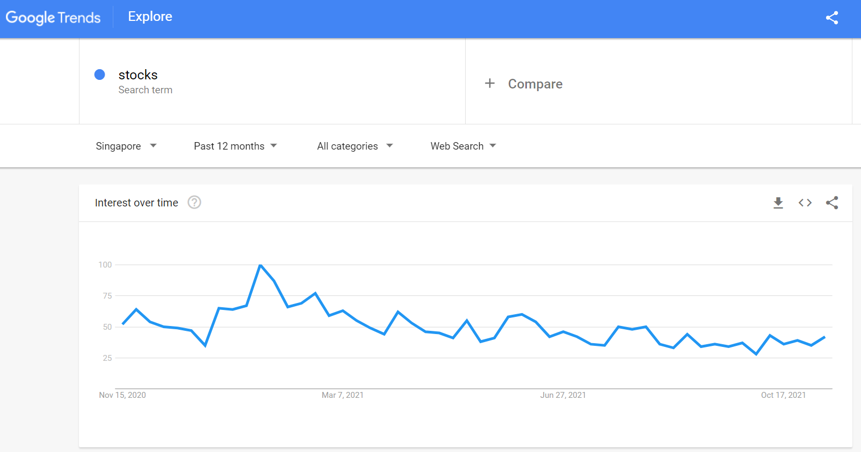
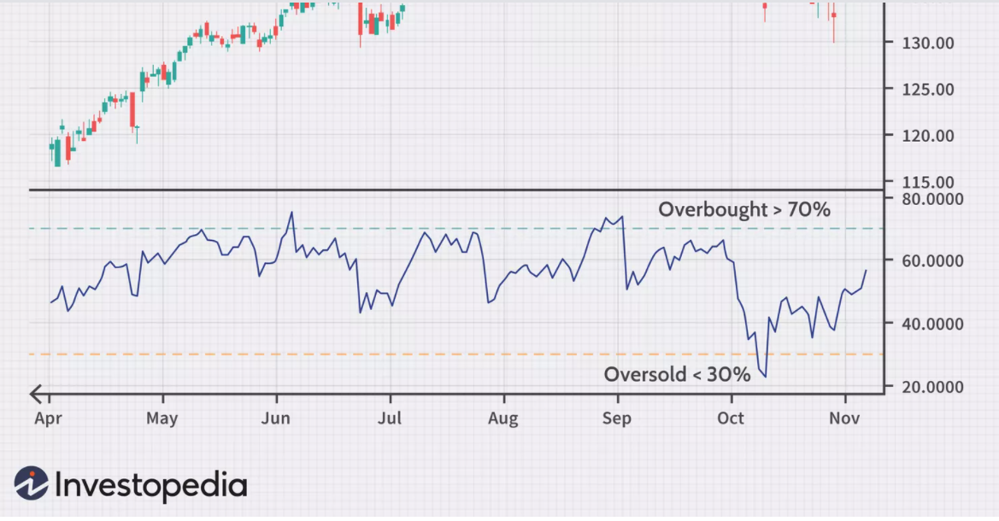
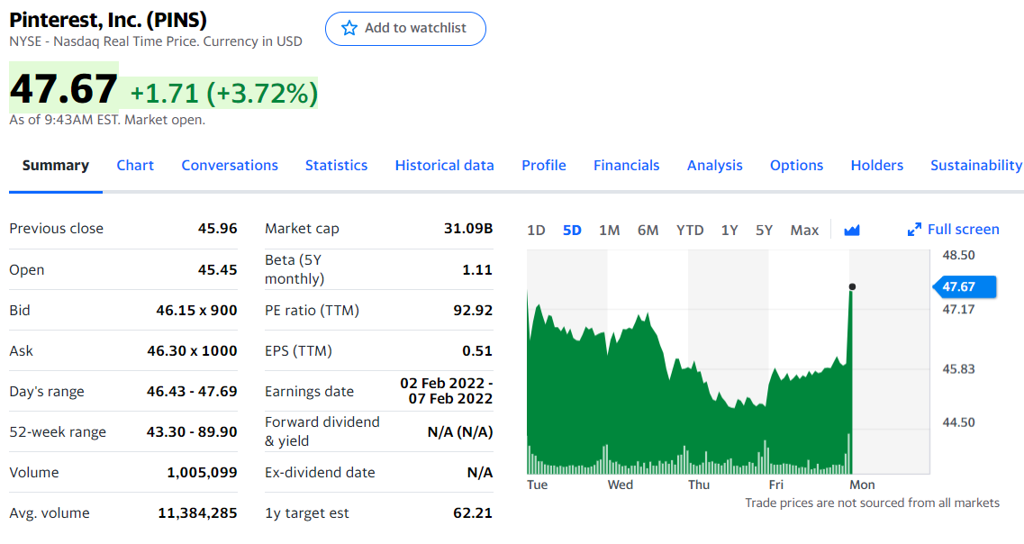
Data Collection and Processing
Market data collected for this project is large from Yahoo! finance and WSJ markets website.
Data is collected on the daily timeframe for the past 5 years.
Data used to represent new-based hype for markets is collected from Google Trends by searching for key words.
Market indicators are generated using the TA-Lib Python library
Strategies used to apply the market indicators to make trades are based on information from Investopedia and Wysetrade.

Slide 16
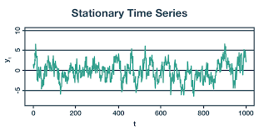
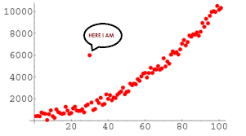
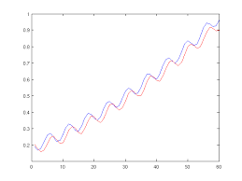
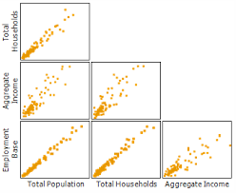
Model Assumptions
Stationarity – Data is collected across a relatively short time (5 years), true characteristics of the dataset considered to be in flux, model performance was also compared between stationary periods and non-stationary periods to determine signifiance of stationarity
True Lag Length – Used Baye’s Information Criteria to determine lag=1 is the best fit. Congruent with understanding that assumption market conditions change quickly and increasing the lag could result in increased noise
Large Outliers – Checked for using the Python statsmodels library and found to be absent
Multicollinearity – Checked for using the Python statsmodels library and found to be absent

Slide 17
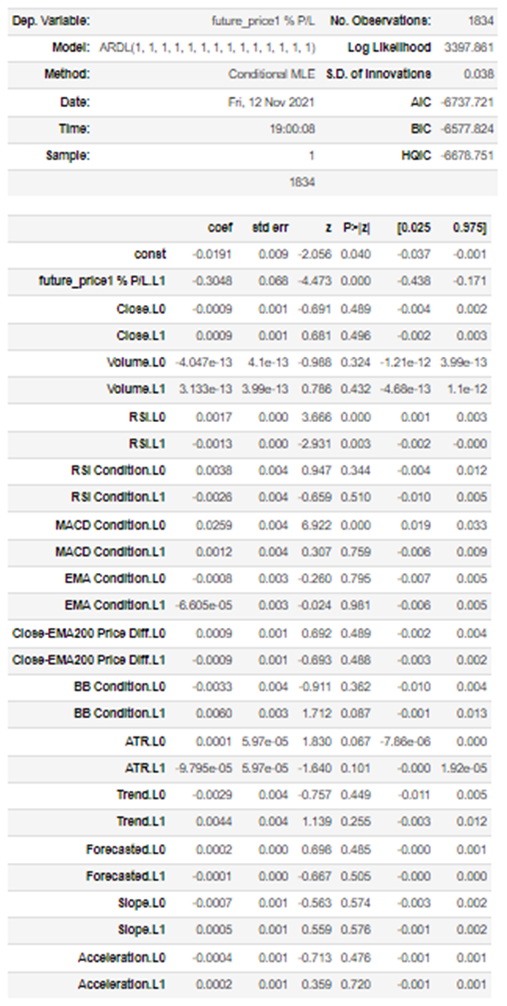
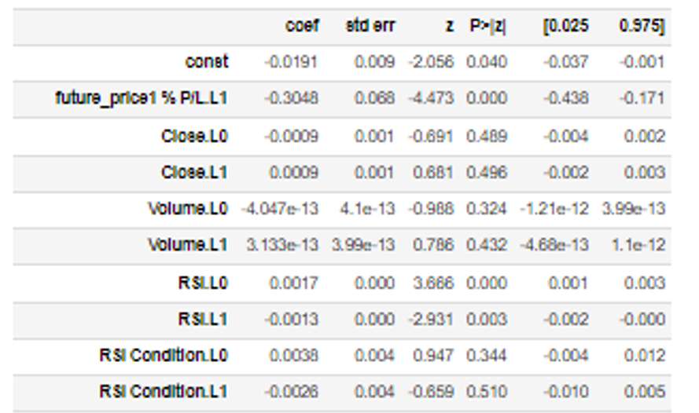
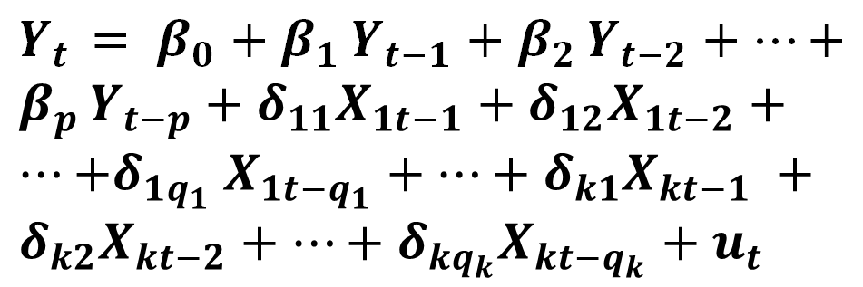
Main Model
The basic ADL model allows for k additional predictors, with q₁ lags of the first predictor are included along with q_{i} lags of the ith predictor takes the following form:
$Y_{t }$ $= β_{0}+β_{1 }Y_{t−1}+β_{2 }Y_{t−2}+…+β_{p }Y_{t−p}+δ_{11}X_{1t−1}+δ_{12}X_{1t−2}+…{+δ}_{1q_{1}}X_{1t−q_{1}}+…+δ_{k1}X_{kt−1} +δ_{k2}X_{kt−2}+…+δ_{kq_{k}}X_{kt−q_{k}}+u_{t}$

Slide 18
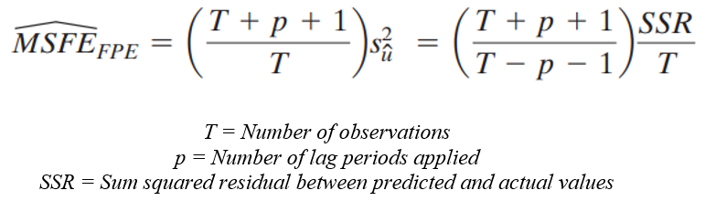
Model Assessment

Slide 19
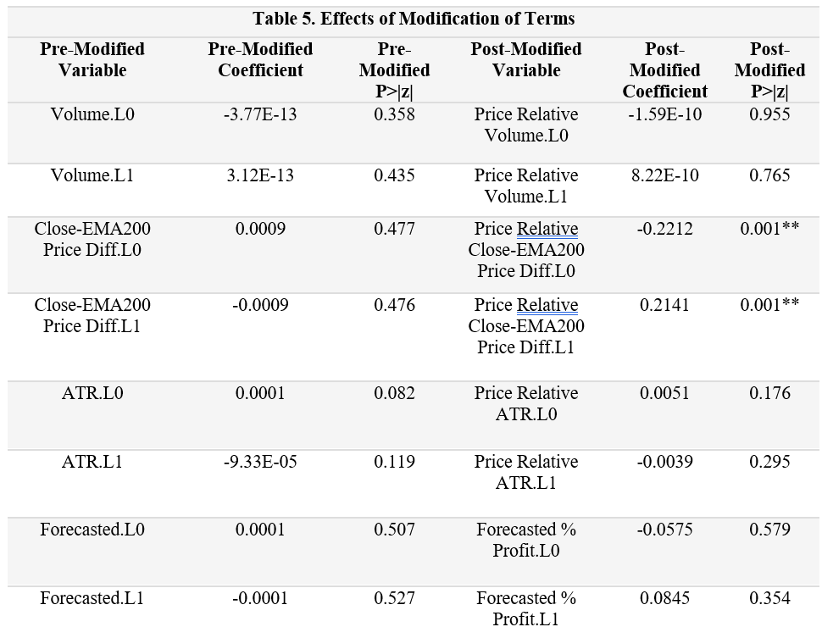
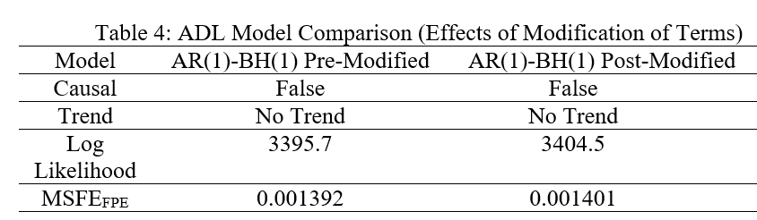
Fixing Terms

Slide 20
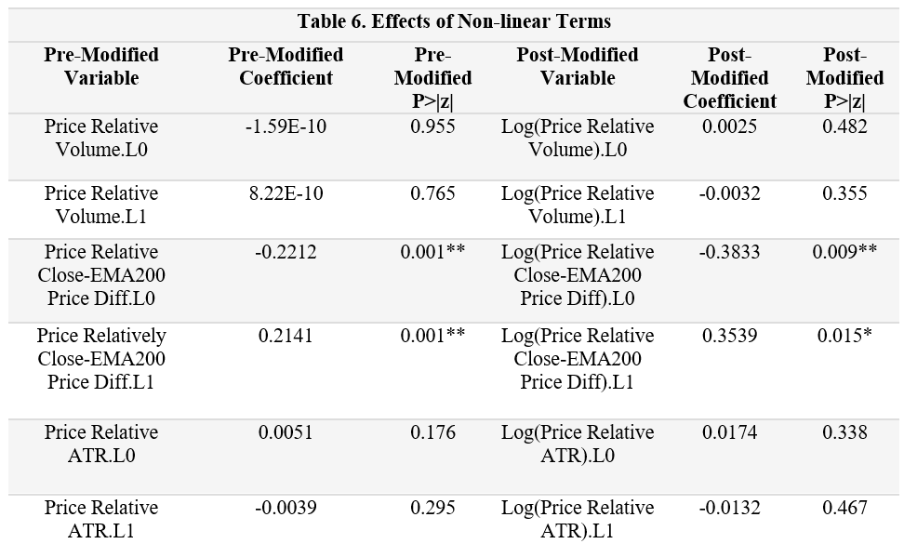
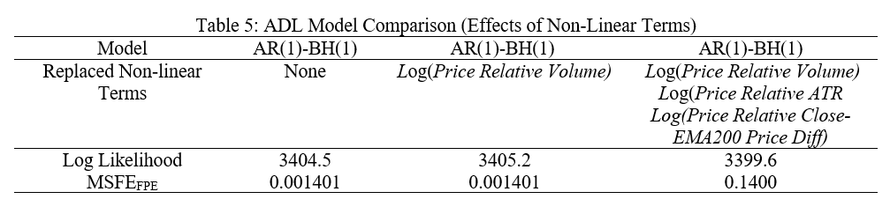
Non-Linear Terms

Slide 21
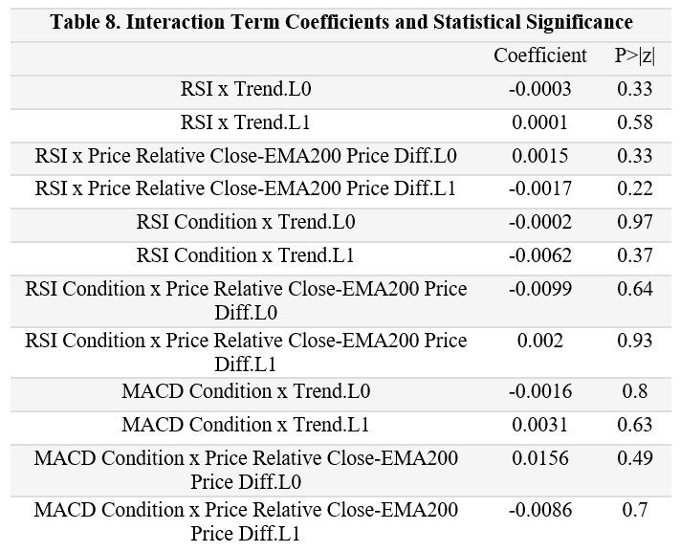
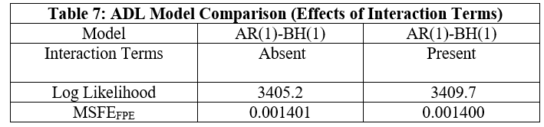
Interaction Terms

Slide 22

Robustness Checks

Slide 23
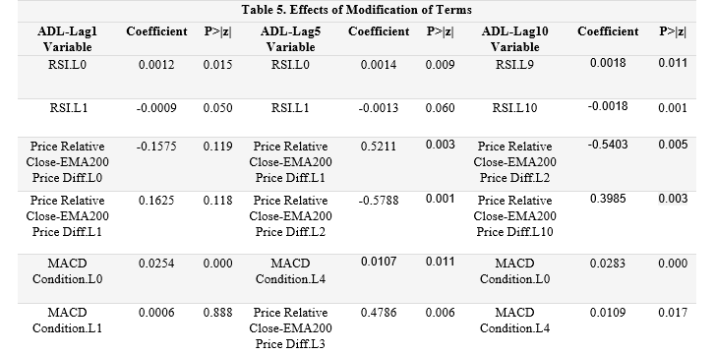
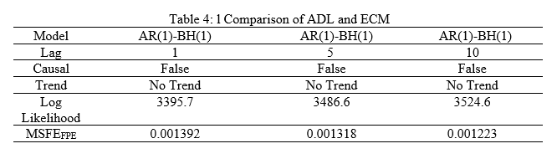
ADL with Different Lag
Notes:
According to our conclusion in the previous section, the three indicators RSI MACD condition and Price Relative Close - EMA200 Price Diff are the most statistically significant with price, in this section we explore whether these three indicators remain statistically significant with price in different models.
Considering that the ADL model contains lags for each indicator, however, different lags of each indicator have different relevance to the price, so we set different lags for the ADL model for comparison. as shown in table, still the RSI MACD condition and Price Relative Close-EMA200 Price were statistically significant across different models.
For RSI indicator, when the lag range is extended, RSI.L9 and RSI.L10 become more statistically significant compared with RSI.L0 and RSI.L1. RSI only describes a trend and does not directly give a suggestion to but or sell, but needs to be combined with other indicators to make a decision, so it is understandable that RSI prefers a larger lag.
For MACD Condition indicator, when the lag range is extended, MACD Condition.L0 and MACD Condition.L4 become most statistically significant. MACD is a technical indicator describing the time of buying or selling, the immediacy of MACD Condition.L0 is better and because it use the average of some data, thus MACD condition with a bit lag may also be very correlated with price.
(Click) Moreover, MSFE decreases with increase of the lag. This is probably because ADL with Lag10 has more parameters, so the model can better fit the function between indicator and price.

Slide 24
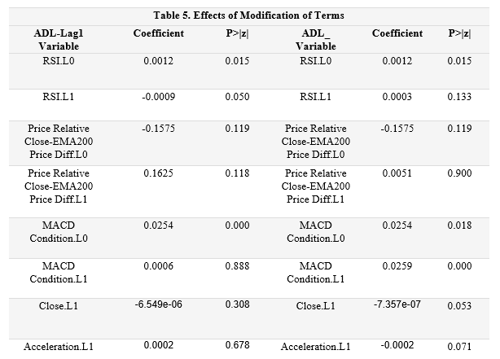
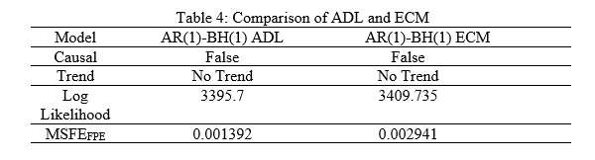
Error Correction Model (ECM)
Notes:
Error Correction Model is commonly used on time series data as well. Because the model is more complicated, so I don’t give the definition of this model, just analyze the result.
Overall, it is still the RSI, MACD condition and Price Relative Close - EMA200 Price Diff most statistically significant with prices. However for the ECM model, Close.L1 and Accelerate.L1 become more significantly correlated with prices compared to the ADL model.
(click) Moreover, MFSE score becomes lower with ECM model. The reason why the ECM model has a lower MSFE needs more exploration.

Slide 25
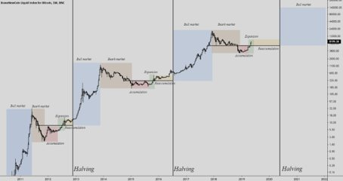
Significant Events
Bitcoin Upgrade | Halving Dates | Bitcoin Bull Runs
 |  | 2011
15 May 2013 | November 2012 | 2013
24 August 2017 | 9 July 2016 | 2017
November 2021 | May 2020 | 2021

Slide 26
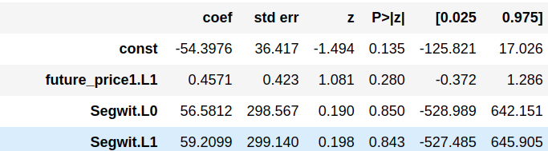
Significant Events – SegWit 24 Aug 2017
Run ARDL using a dummy variable to model before and after event
Results show that event is not statistically significant

Slide 27
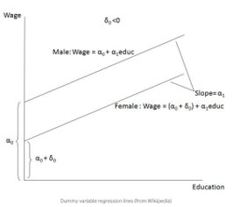
Non-stationarity: Structural Breaks
Addition of Dummy variable
Change in slope of the line

Slide 28
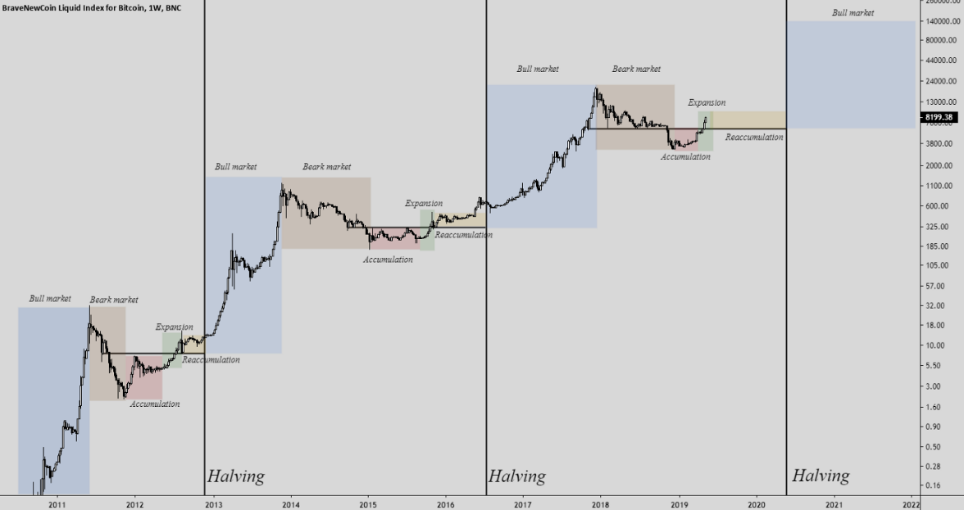
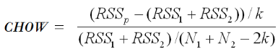
Structural Breaks - Chow Test
Take the timeframe 6 months before, and 6 months after event
Results show that event is statistically significant for BTC-USD, with p-value of 1.68e-12

Slide 29
Structural Breaks - Tests
Chow test using the Structural Break event SegWit is statistically significant for BTC-USD price
p-value of 1.68e-12
Statistically significant for Future_price(1) - Close price.
P-value of 0.00029
Insignificant for Future_price(3) and more
Insignificant for technical indicators RSI, MACD Condition, Price Relative Close-EMA200 Price Diff
Chow test for 2016 Halving event provide similar results to SegWit event

Slide 30
Structural Breaks - Results
Overall results are as expected
Matches what we see on the BTC-USD chart
Results are statistically insignificant for Technical indicators
Means that usage of technical indicators for predicting future prices is not affected by events affecting Bitcoin's prices
Better off following just technical indicators than also looking at events happening for Bitcoin

Slide 31
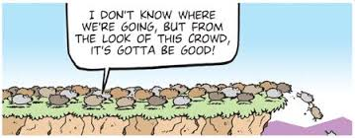
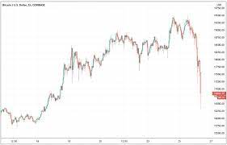
Herd Mentality

Slide 32
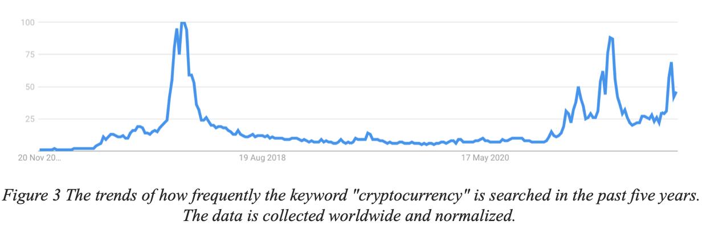
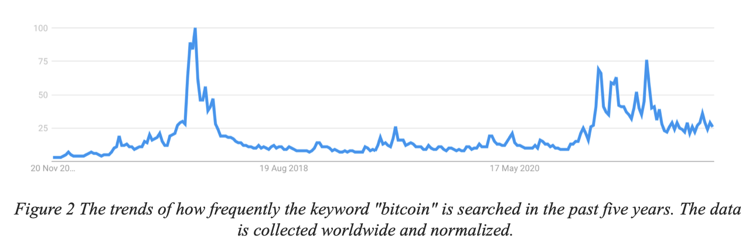
Google Trends Data

Slide 33
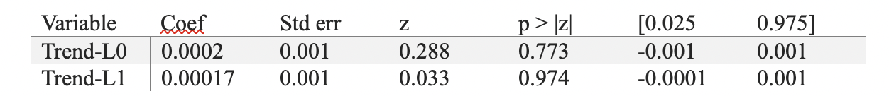
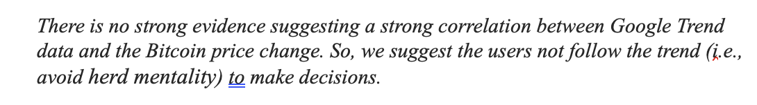
Does Google Trends Data Help?

Slide 34
Robustness Checks
To perform robustness check,
Involve new control variables into our main model, e.g., Google Trend
Variable modification:
change the forecasted to the percentage of the forecasted profit
We take the log of some variable variables that may have a non-linear relationship with the profit
We run our model with different lag
We fit our data into RMA model
Our findings are:
The coefficient of variables in most models are all similar in terms of significance.
Notes:
There are some exceptions but it’s hard to tell the reason. Only mentioning them without any reason would hurt our model. I just ignore them.

Slide 35
Trading Strategy and Model Evaluation

Slide 36



Evaluating Model Performance Trading Strategies
Signal
MACD/RSI
Trend Strength
Price Difference with EMA200
Volatility
ATR

Slide 37
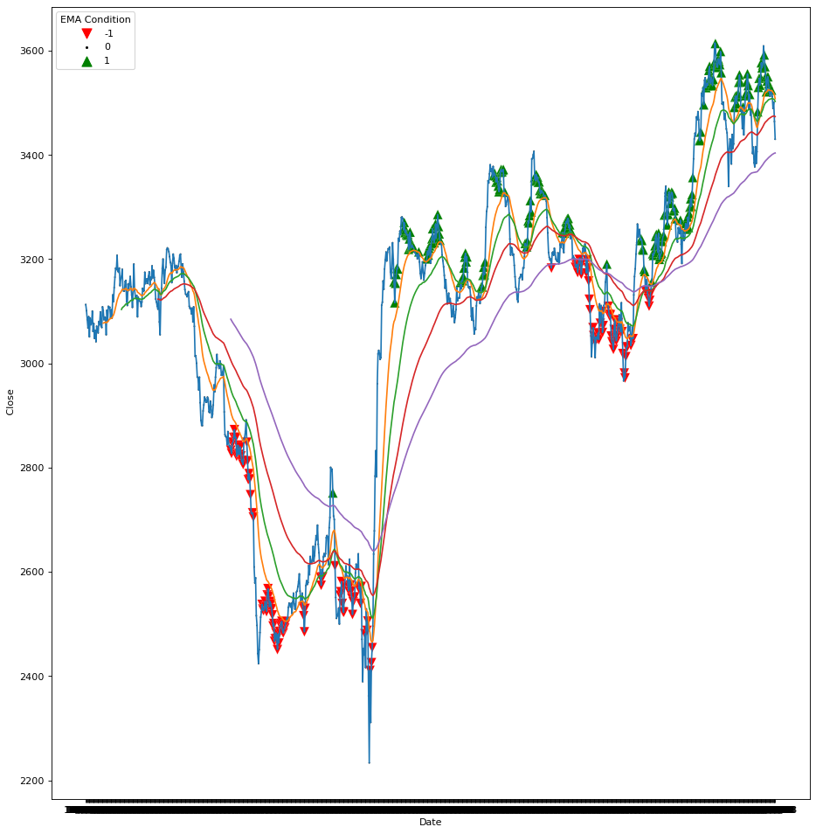
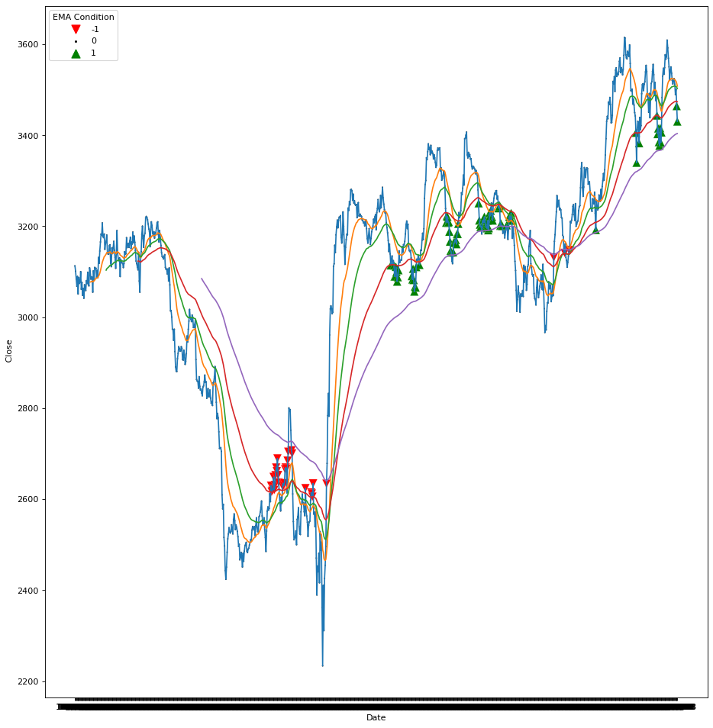
Evaluating Model Performance Trading Strategies

Slide 38
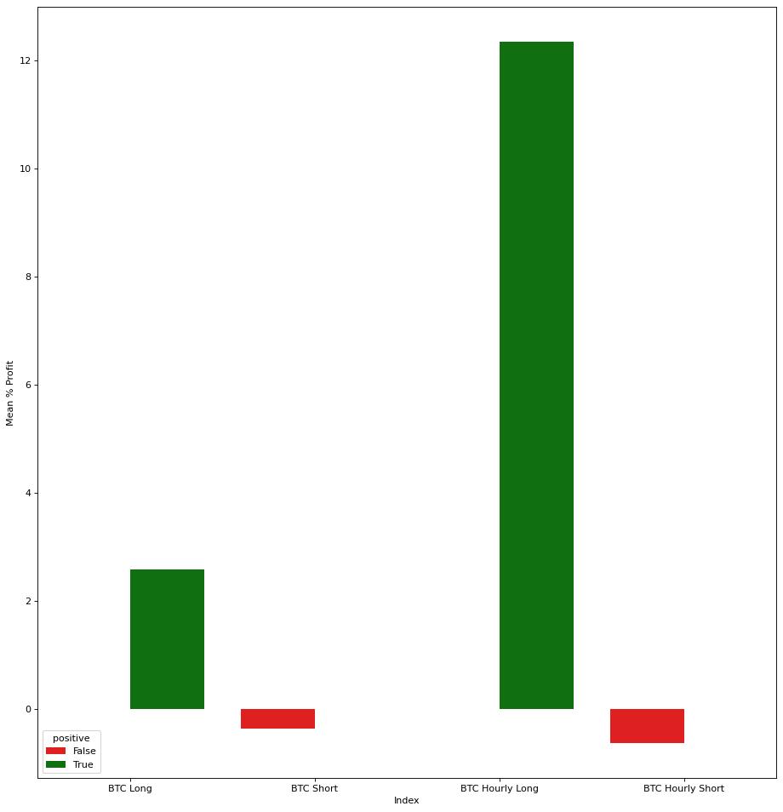
Evaluating Model Performance Trading Timeframes
BTC Trading Performance
12%
3%
Daily
Hourly

Slide 39
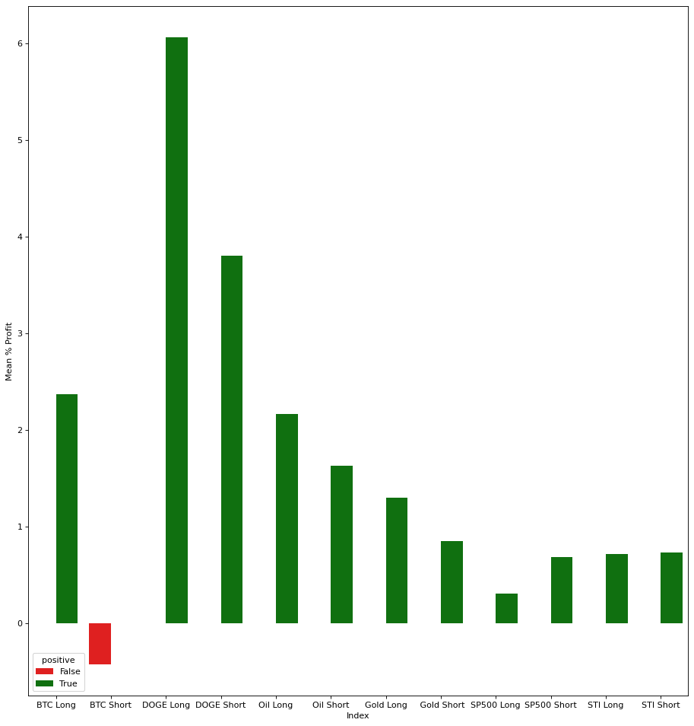
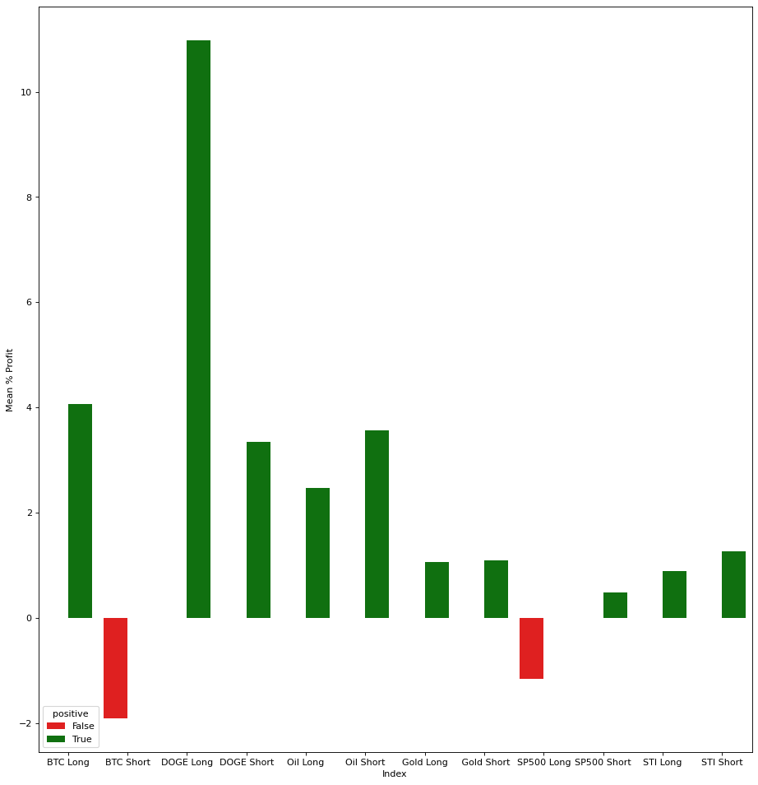
Evaluating Model Performance Trading Holding Times
6%
Hold Trades for 1 Day
12%
Hold Trades for 3 Days
1.68% return on average
2.17% return on average

Slide 40
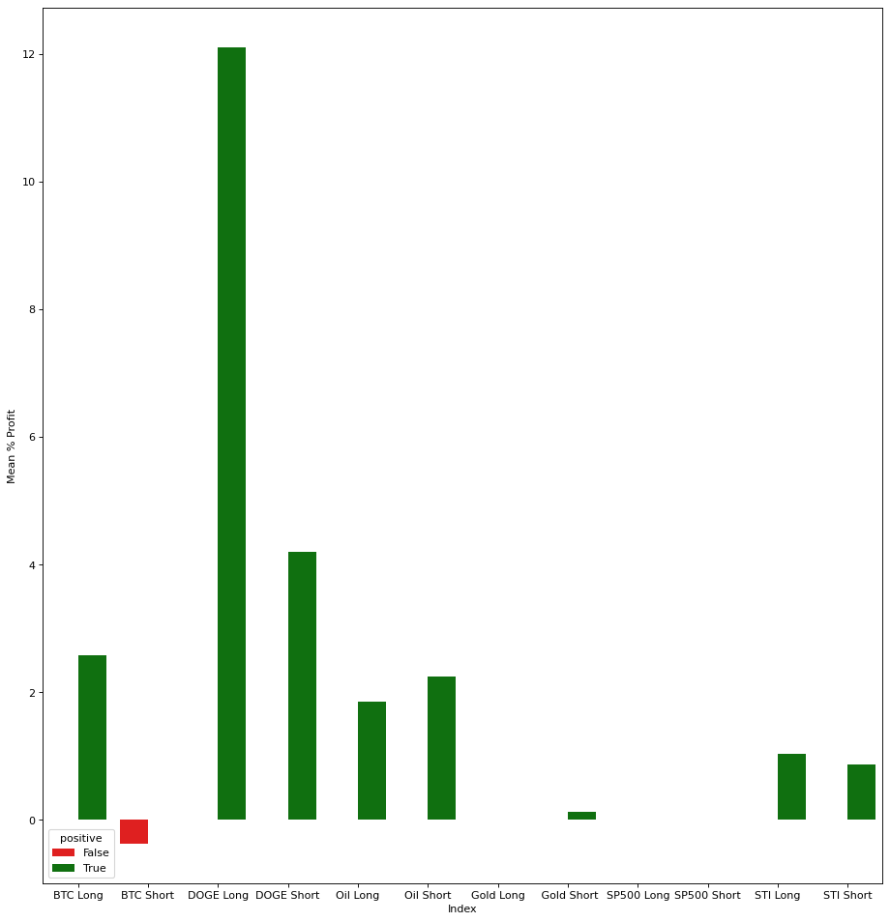
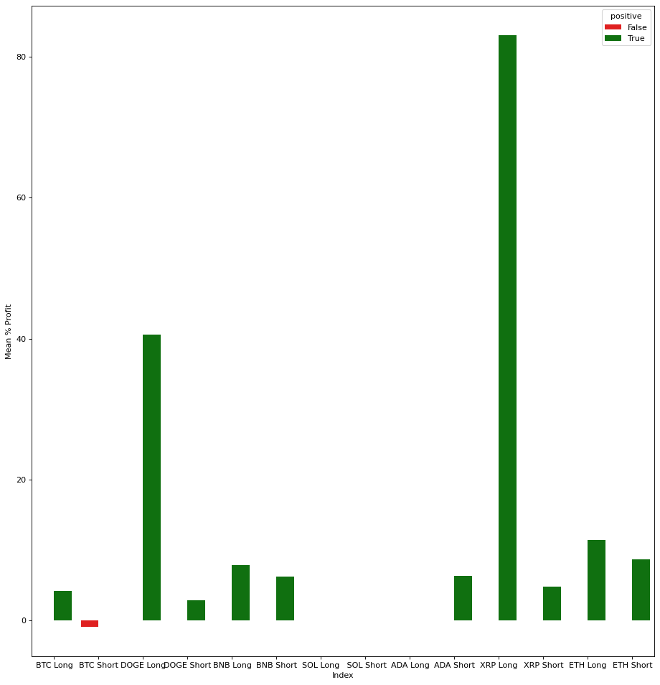
Evaluating Model Performance Alternative Cryptocurrency Markets
12%
Crypto, Equities, Commodities
83%
Crypto, Crypto, Crypto

Slide 41

Conclusion (Top Ten Trading Tips)
Time Series Regression can identify indicators that are significant
Exploring different models can yield different insights
Considering trades from different angles increases trade quality
Testing the optimum holding time for a strategy is critical for profit
Testing a strategy on different markets helps to identify better performing
Higher trade quality = Lower trade quantity
MACD is a good technical indicator for trading
Reversal based trading strategies benefit from strong trends
Reversal based trading strategies do better in low volatility
Do not join the hype
Unless justified by the price action
Always trade with the trend
If you can quantify the strength of the trend, even better

Slide 42


